Slide 1
Effect of temperature in fermi level
Dr.a.anbarasi
Associate professor in physics
Periyar arts college cuddalore

Slide 2
The probability of occupation of energy levels in valance and conduction band is represented in terms of Fermi level.
As the temperature increases, free electrons and holes gets generated which results in shift of Fermi level accordingly.
In intrinsic semiconductor, the no. of electrons in conduction band and no. of holes in valance band are equal. The probability of occupation of energy levels in valance and conduction band are equal.

Slide 3
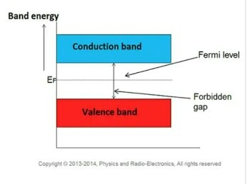
Band energy

Slide 4
Fermi level of intrinsic semiconductor
Hence, the Fermi level for intrinsic semi conductor lies in the middle of the forbidden band.
In extrinsic semiconductor, the no. of electrons in conduction band and no. of holes in valance band are not equal.
Fermi level in n-type semiconductor
In n-type semiconductor, pentavalent impurity is added which donates a free electron. This creates large no. of free electrons in conduction band.
At room temperature, no. of electrons in conduction band are greater than no. of holes in valance band. The probability of occupation of energy levels by electrons in conduction band is greater than that of holes in the valance band.

Slide 5
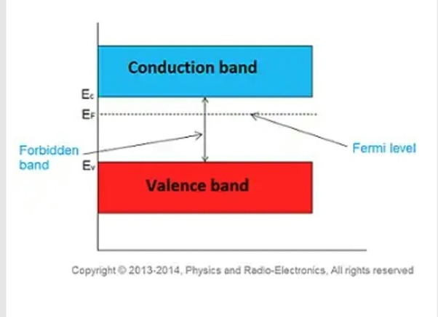
Fermi energy

Slide 6
Fermi level of semiconductors
Therefore, the Fermi level in n-type lies closer to the conduction band.
As the temperature increases, the Fermi level shifts towards the conduction band.
Fermi level in p-type semiconductor
In p-type semiconductor, trivalent impurity is added which creates hole in valance band and is ready to accept an electron. This creates large no. of holes in the valance band.
At room temperature, the no. of holes in the valance band are greater than the no. of electrons in conduction band. The probability of occupation of energy levels by holes in valance band is greater than that of the electrons in conduction band.

Slide 7
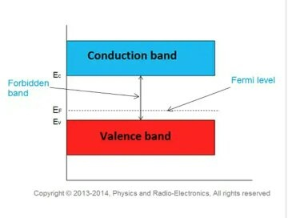
Fermi level

Slide 8
Temperature increases fermi level shifts
Therefore, the Fermi level for p-type lies closer to the valance band.
As the temperature increases, the Fermi level for p-type shifts towards the valance band.

Slide 9
Fermi level and its changes
The Fermi level lies between the valence band and conduction band because at absolute zero temperature the electrons are all in the lowest energy state. ... The Fermi level changes as the solids are warmed and as electrons are added to or withdrawn from the solid.

Slide 10
Fermi level changes with temperature
Does Fermi energy depend on temperature?
The experiment shows that the Fermi level decreases with increasing temperature and has almost the same temperature dependence as the energy gap. It is pinned at about 0.63 of energy gap below the conduction band.

Slide 11
Fermi energy
What is the formula of Fermi energy?
Fermi Energies for Metals
We can also turn this around and express the Fermi energy in terms of the free electron density. For a metal with Fermi energy E_{F} = eV, the free electron density is n = x10^ electrons/m³.

Slide 12
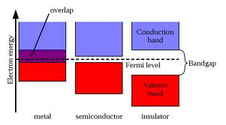
Fermi level
What do you understand by Fermi level?
The Fermi Level is the energy level which is occupied by the electron orbital at temperature equals 0 K. The level of occupancy determines the conductivity of different materials
This Photo by Unknown Author is licensed under CC BY-SA

Slide 13
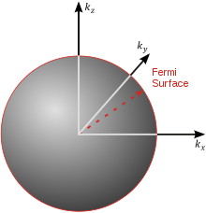
What is the Fermi radius?
In reciprocal space, the Fermi surface of an ideal Fermi gas is a sphere of radius. , determined by the valence electron concentration where. is the reduced Planck's constant. A material whose Fermi level falls in a gap between bands is an insulator or semiconductor depending on the size of the bandgap
This Photo by Unknown Author is licensed under CC BY-SA

Slide 14
Is Fermi energy constant?
The value of the Fermi level at absolute zero temperature (−273.15 °C) is known as the Fermi energy. It is also the maximum kinetic energy an electron can attain at 0K. Fermi energy is constant for each solid.

Slide 15

Energy spectrum
What are the factors on which Fermi energy depends?
the nature and concentration of the impurity in the semiconductor; 2. the temperature. These two factors make the Fermi level moveable within the energy spectrum.

Slide 16
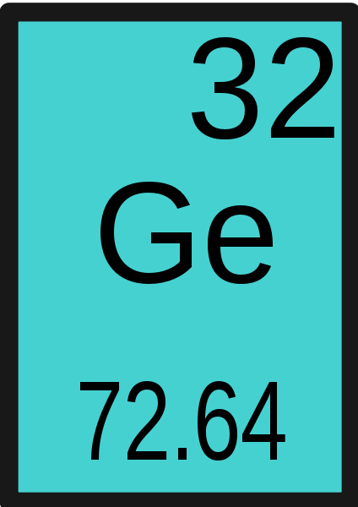
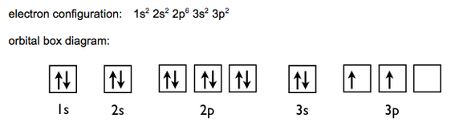
Silicon & germanium
Which is better silicon or germanium?
The structure of Germanium crystals will be destroyed at higher temperature. However, Silicon crystals are not easily damaged by excess heat. Peak Inverse Voltage ratings of Silicon diodes are greater than Germanium diodes. Si is less expensive due to the greater abundance of element.
This Photo by Unknown Author is licensed under CC BY-SA
This Photo by Unknown Author is licensed under CC BY-SA
This Photo by Unknown Author is licensed under CC BY-SA

Slide 17
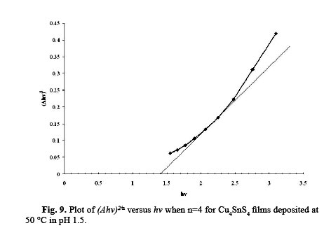
Tauc plot
How is band gap measured?
The direct optical band gap of semiconductors is traditionally measured by extrapolating the linear region of the square of the absorption curve to the x-axis, and a variation of this method, developed by Tauc, has also been widely used.

Slide 18
Fermi pressure
What is Fermi pressure?
The Pauli exclusion principle disallows two identical half-integer spin particles (electrons and all other fermions) from simultaneously occupying the same quantum state. ... The result is an emergent pressure against compression of matter into smaller volumes of space.

Slide 19
Why do electrons move faster than holes?
As electrons are of lighter mass than holes so their acceleration are more than that of holes which follow drift velocity inside conductor,making electron move much faster.

Slide 20

Tunnel diode
A tunnel diode (also known as a Esaki diode) is a type of semiconductor diode that has effectively “negative resistance” due to the quantum mechanical effect called tunneling. Tunnel diodes have a heavily doped pn junction that is about 10 nm wide.

Slide 21
A tunnel diode or Esaki diode is a type of semiconductor diode that has effectively "negative resistance" due to the quantum mechanical effect called tunneling. It was invented in August 1957 by Leo Esaki, Yuriko Kurose, and Takashi Suzuki when they were working at Tokyo Tsushin Kogyo, .

Slide 22
Tunnel Diode is the P-N junction device that exhibits negative resistance. When the voltage is increased than the current flowing through it decreases. It works on the principle of the Tunneling effect.

Slide 23
A Tunnel diode is a heavily doped p-n junction diode in which the electric current decreases as the voltage increases. In tunnel diode, electric current is caused by “Tunneling”. The tunnel diode is used as a very fast switching device in computers. It is also used in high-frequency oscillators and amplifiers.

Slide 24
What is tunnel diode and its working?
A Tunnel Diode is a heavily doped p-n junction diode. The tunnel diode shows negative resistance. When voltage value increases, current flow decreases. Tunnel diode works based on Tunnel Effect. ... Therefore, it is also called as Esaki diode.

Slide 25
How tunnel diode is used as oscillator?
The oscillator circuit that is built using a tunnel diode is called as a Tunnel diode oscillator. If the impurity concentration of a normal PN junction is highly increased, this Tunnel diode is formed. It is also known as Esaki diode, after its inventor.

Slide 26
What is the difference between zener diode and tunnel diode?
A zener diode is used for voltage regulation. ... The zener is used for voltage reference, as well as to limit certain voltages where 1 or 2 diodes would not provide the needed voltage level for a circuit. The Tunnel diode can be used as an amplifier, or usually as an oscillator, but it can also be used as a switch.

Slide 27
What is diode and its types?
An Overview on Different Types of Diodes and Their Uses. A diode is a two-terminal electrical device, that allows the transfer of current in only one direction. The diode is also known for its unidirectional current property, where the electric current is permitted to flow in one direction.

Slide 28


Slide 29
Semiconductor objective type questions and answers
Q1. A semiconductor is formed by ……… bonds.
Covalent
Electrovalent
Co-ordinate
None of the above
Answer : 1

Slide 30
Q2. A semiconductor has ………… temperature coefficient of resistance.
Positive
Zero
Negative
None of the above
Answer : 3

Slide 31
Q3 The most commonly used semiconductor is ………..
Germanium
Silicon
Carbon
Sulphur
Answer : 2

Slide 32
Q4. A semiconductor has generally ……………… valence electrons.
2
3
6
4
Answer : 4

Slide 33
5. The resistivity of pure germanium under standard conditions is about ……….
6 x 10⁴
Ω cm
60
Ω cm
3 x 10⁶
Ω cm
6 x 10⁻⁴
Ω cm
Answer : .52 ohm

Slide 34
6. The resistivity of a pure silicon is about ……………
100 Ω cm
6000 Ω cm
3 x 10⁵ Ω m
6 x 10⁻⁸ Ω cm
Answer : 2

Slide 35
7. When a pure semiconductor is heated, its resistance …………..
Goes up
Goes down
Remains the same
Can’t say
Answer : 2

Slide 36
9)The strength of a semiconductor crystal comes from ……..
Forces between nuclei
Forces between protons
Electron-pair bonds
None of the above
Answer : 3

Slide 37
Q10. Addition of pentavalent impurity to a semiconductor creates many ……..
Free electrons
Holes
Valence electrons
Bound electrons
Answer : 1

Slide 38
Q11. A pentavalent impurity has ………. Valence electrons
3
5
4
6
Answer : 2

Slide 39
Q.12. An n-type semiconductor is ………
Positively charged
Negatively charged
Electrically neutral
None of the above
Answer : 3

Slide 40
Q13. A trivalent impurity has ….. valence electrons
4
5
6
3
Answer : 4

Slide 41
Q14. Addition of trivalent impurity to a semiconductor creates many ……..
Holes
Free electrons
Valence electrons
Bound electrons
Answer : 1

Slide 42
Q15. A hole in a semiconductor is defined as …………….
A free electron
The incomplete part of an electron pair bond
A free proton
A free neutron
Answer : 2

Slide 43
Q16. The impurity level in an extrinsic semiconductor is about ….. of pure semiconductor.
10 atoms for 10⁸ atoms
1 atom for 10⁸ atoms
1 atom for 10⁴ atoms
1 atom for 100 atoms
Answer : 2

Slide 44
Q17. As the doping to a pure semiconductor increases, the bulk resistance of the semiconductor ………..
Remains the same
Increases
Decreases
None of the above
Answer : 3

Slide 45
Q18. A hole and electron in close proximity would tend to ……….
Repel each other
Attract each other
Have no effect on each other
None of the above
Answer : 2

Slide 46
Q19. In a semiconductor, current conduction is due to ……..
Only holes
Only free electrons
Holes and free electrons
None of the above
Answer : 3

Slide 47
Q20. The random motion of holes and free electrons due to thermal agitation is called ……….
Diffusion
Pressure
Ionisation
None of the above
Answer : 1

Slide 48
Q21. A forward biased pn junction diode has a resistance of the order of
Ω
kΩ
MΩ
None of the above
Answer : 1

Slide 49
Q22. The battery connections required to forward bias a pn junction are ……
+ve terminal to p and –ve terminal to n
-ve terminal to p and +ve terminal to n
-ve terminal to p and –ve terminal to n
None of the above
Answer : 1

Slide 50
Q23. The barrier voltage at a pn junction for germanium is about ………
5 V
3 V
Zero
3 V
Answer : 4

Slide 51
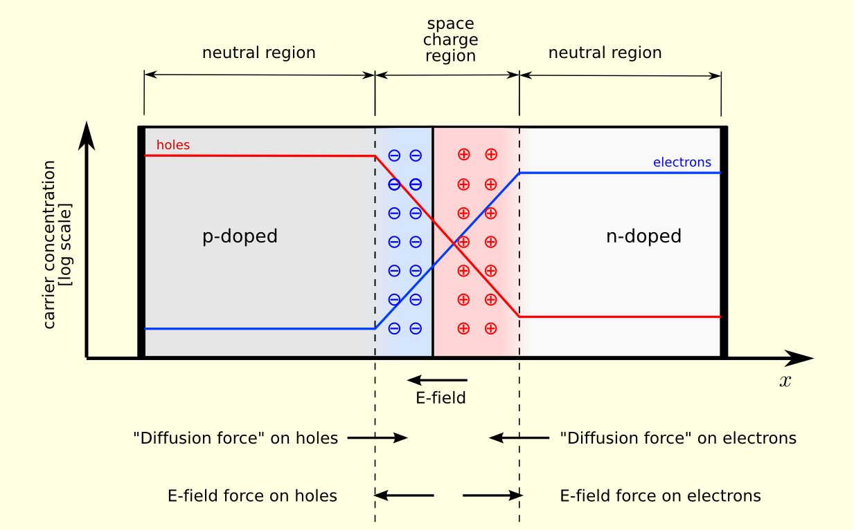
Q24. In the depletion region of a pn junction, there is a shortage of ……..
Acceptor ions
Holes and electrons
Donor ions
None of the above
Answer : 2

Slide 52
Q25. A reverse bias pn junction has …………
Very narrow depletion layer
Almost no current
Very low resistance
Large current flow
Answer : 2

Slide 53


